Slide 1
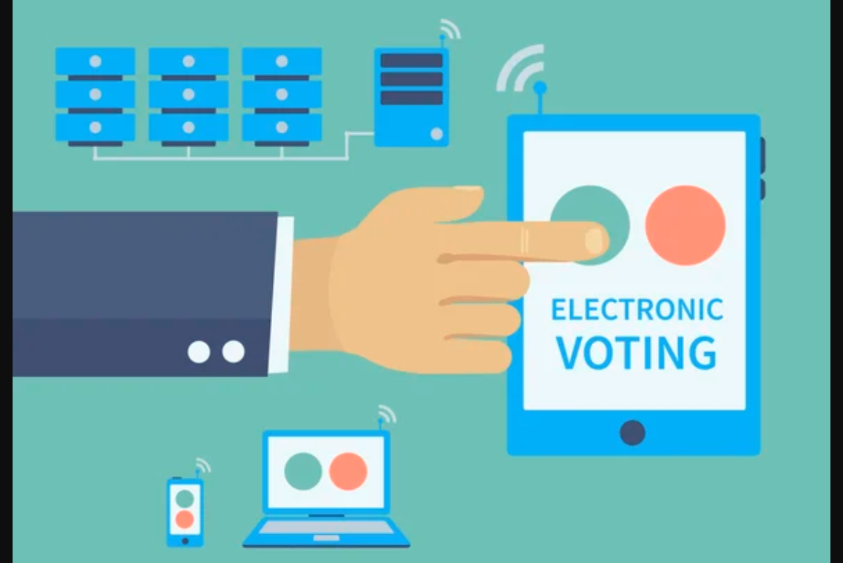
ONLINE VOTING SYSTEM
E-VOTING SYSTEM WITH PHP & MYSQL

Slide 2
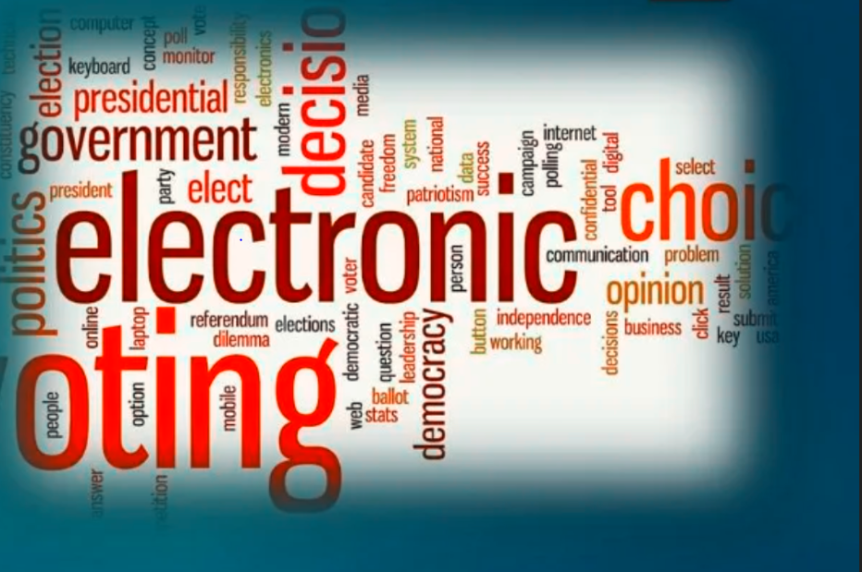
CONTENTS
1
INTRODUCTION
2
PROJECT ANALYSIS
3
SYSTEM DESIGN
4
APPLICATIONS
5
FUTURE POTENTIAL
6
TECHNOLOGIES USED
7
BIBLIOGRAPHY

Slide 3
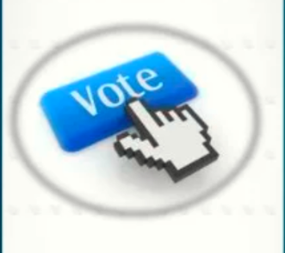
ONLINE VOTING
THE FUTURE OF VOTING & WHY
In this “ONLINE VOTING” system people who have citizenship of India and whose age is above 18 years of age and have a VOTER ID can give his\her vote online without going to any physical polling station.
There is a database which is maintained in which all the names of voters with complete information are stored.

Slide 4
ONLINE VOTING
PROCESS:
In “ONLINE VOTING SYSTEM” a voter can use his\her voting right online without any difficulty.
He\She has to be registered first for him/her to vote.
Registration is mainly done by the voter itself using his/her unique VOTER ID.
After registration, the voter will login using his/her VOTER ID and password.
The voter can log into the system and enjoy services provided by the system such as voting.
If invalid/wrong details are submitted, then the citizen is not registered to vote.
After the voting is done a confirmation pdf will be available to download.
The RECORD must be stored with voter for later purpose.

Slide 5
PROJECT ANALYSIS
Online voting is an electronic way of choosing leaders via a web driven application.
The advantage of online voting over the common “queue method” is that the voters have the choice of voting at their own free time and there is reduced congestion.
It also minimizes on errors of vote counting.
The individual votes are submitted in a database which can be queried to find out who of the aspirants for a given post has the highest number of votes.
206
2018
2019
This system is geared towards increasing the voting percentage in an area/constituency/company since it has been noted that with the old voting method {the Queue System}, the voter turnout has been a wanting case and the ongoing COVID epidemic.
With system in place also, if high security is applied, cases of false votes shall be reduced.

Slide 6
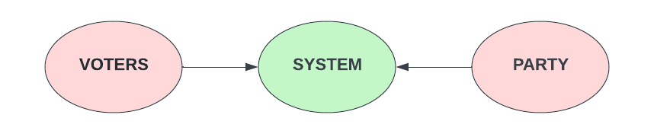
System Design
Voters are the people who will first sign up on online voting panel. And then at the time of voting, they will login and do vote to their respective group or candidate via system.
Following data from voter side will be provided to the system at the time of registration:
• Name • Voter ID • Address • Status
•Votes
•Role (voter/group)
•Photo
•Password

Slide 7
SYSTEM
System is an online platform where election process is held. So, the voters and groups are registered here.
And with the help of system, voters can do voting and groups can monitor their status.
Users can avail the PDF confirmation after casting the vote.
Users can ask for help/support from the system admin.

Slide 8
PARTY
Groups/Candidates/Parties are those who will be given votes at the time of voting. And they can monitor their status by just doing login into system. Following data from group/party side will be provided to the system at the
• Name • VOTER ID • PAN ID • Party name • Password • Address • Upload party symbol

Slide 9
System Design
Voters are the people who will first sign up on online voting panel. And then at the time of voting, they will login and do vote to their respective group or candidate via system.
Following data from voter side will be provided to the system at the time of registration:
• Name • Voter ID • Address • Status
•Votes
•Role (voter/group)
•Photo
•Password

Slide 10
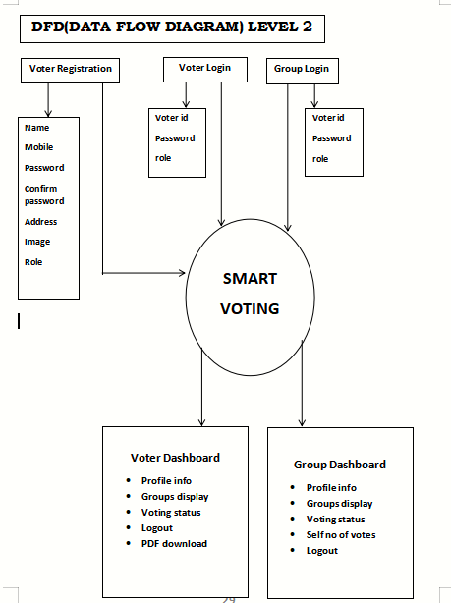
ER DIAGRAM

Slide 11
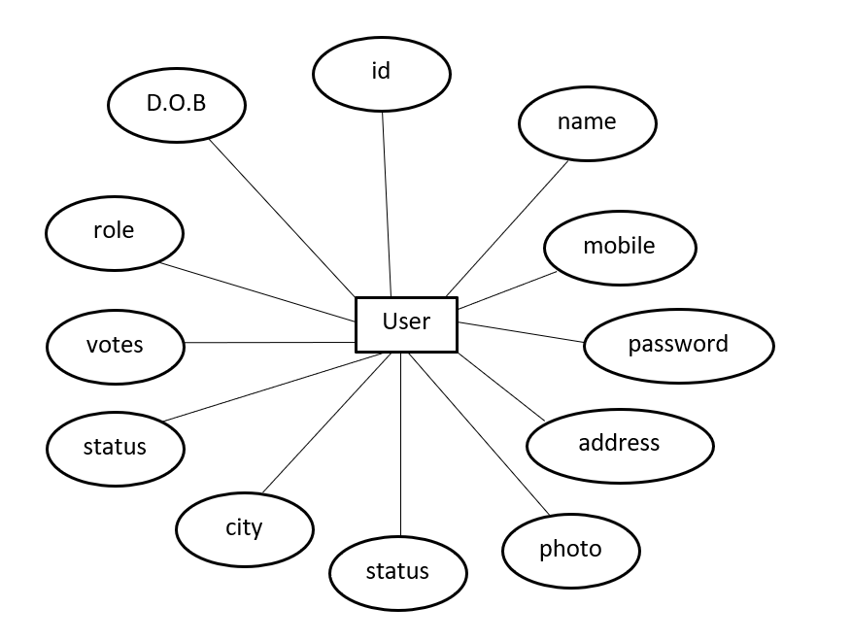
ER DIAGRAM

Slide 12
Applications of VOTING
• School • College • Industry • Corporate • Government • Hospital • Food and Restaurant • Tourism • Sports • Entertainment • Production • Investment • News and Media • Technology
This system is applicable in below fields for election purpose

Slide 13
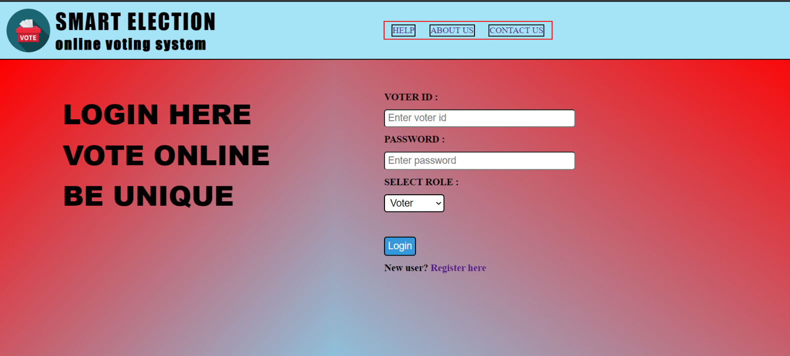
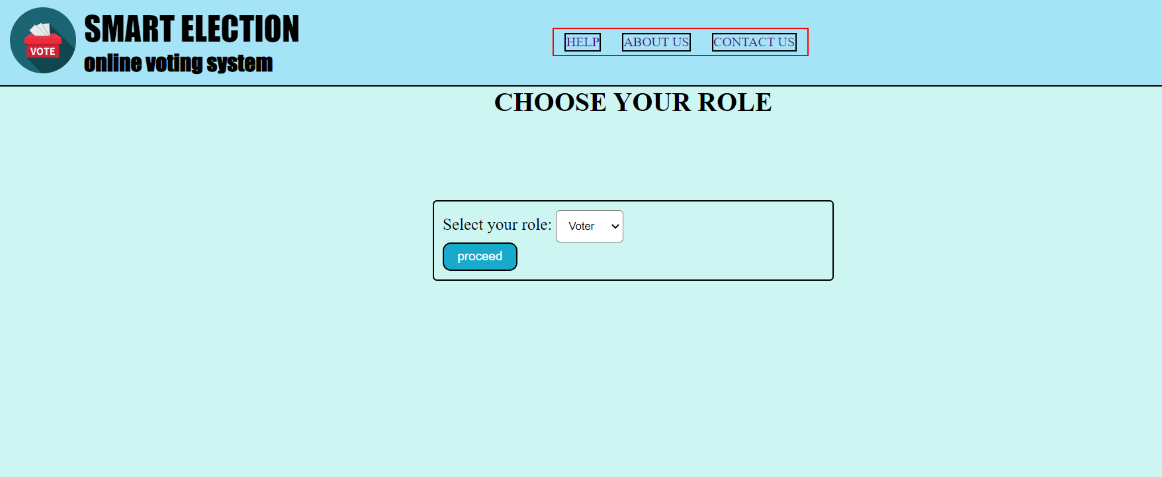
Application Designs
LOGIN PAGE
CHOOSE ROLE

Slide 14
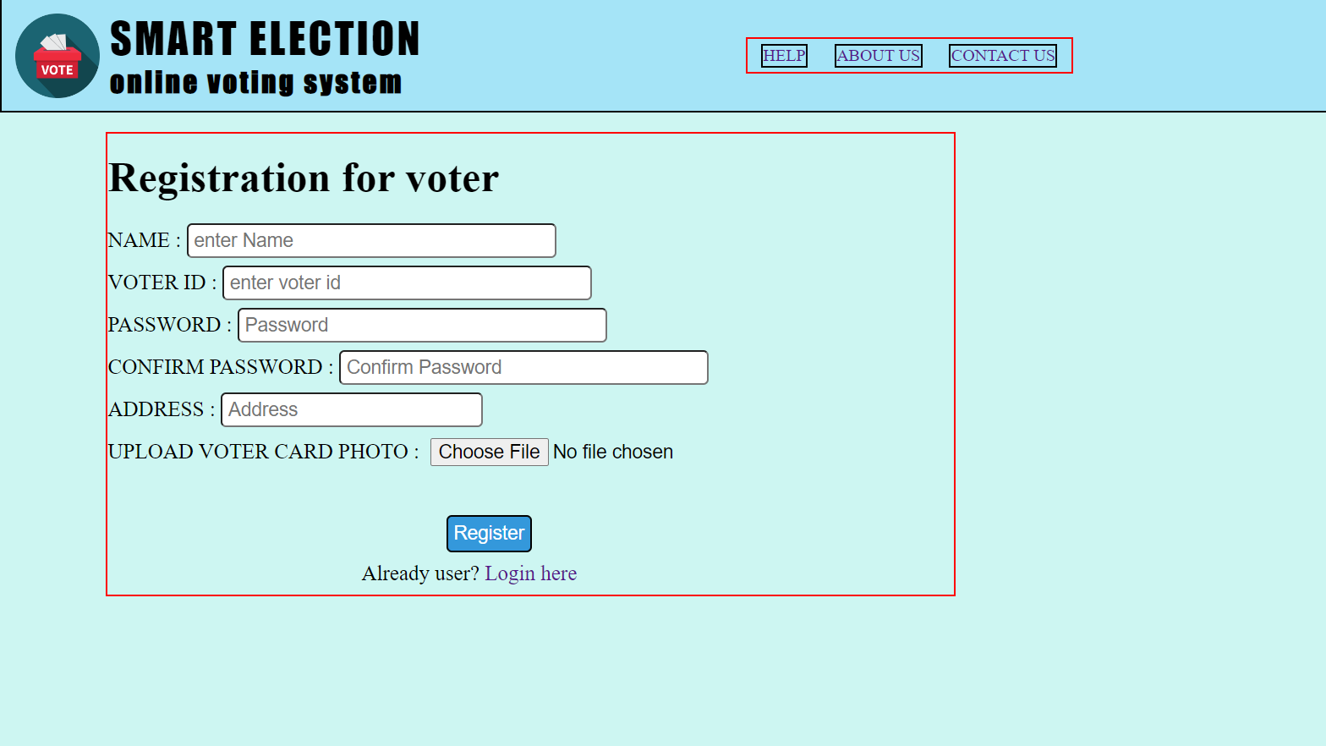
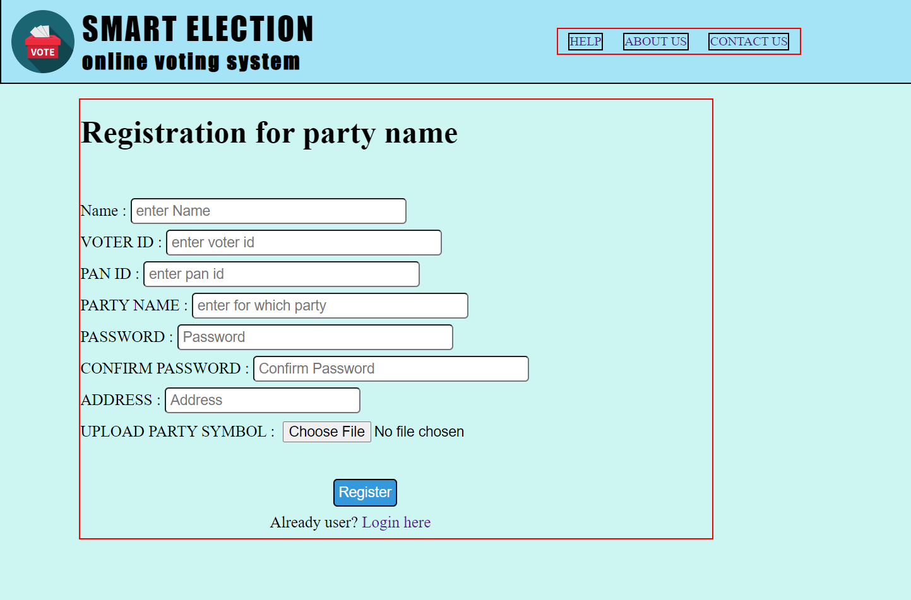
VOTER & PARTY REGISTRATION PAGE

Slide 15
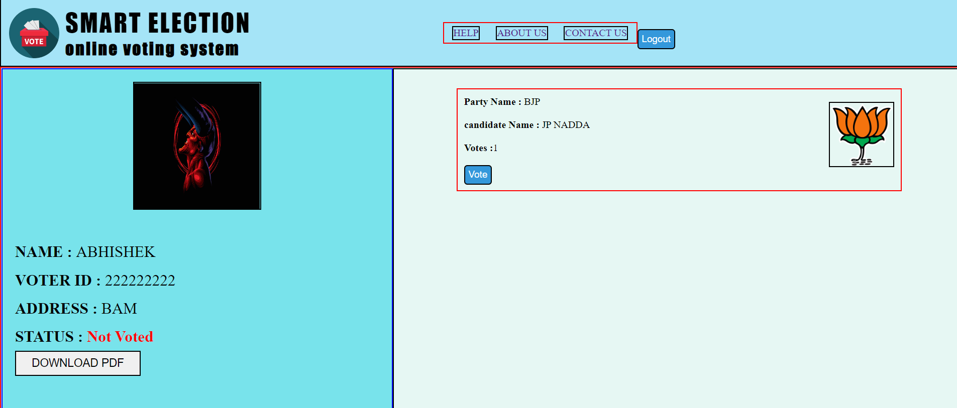
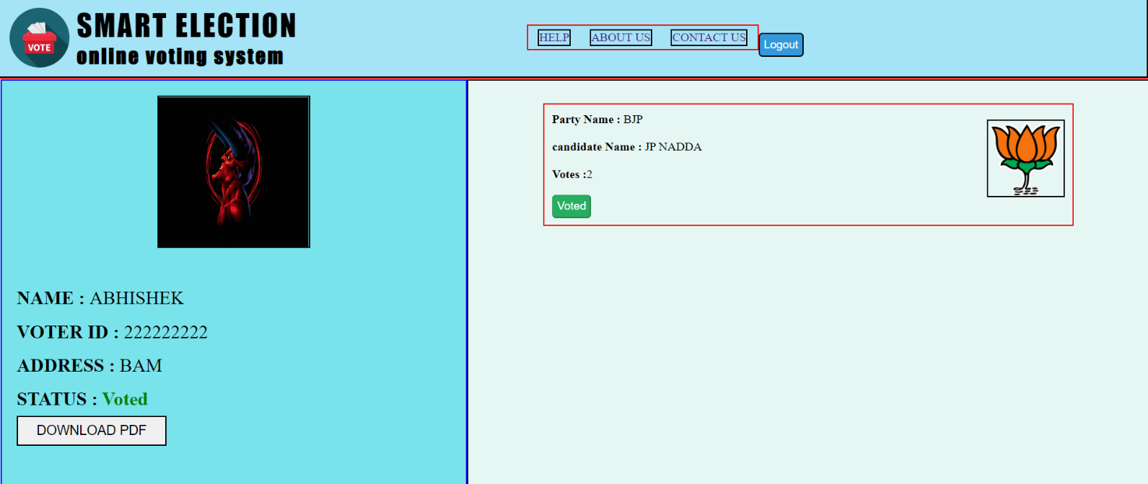
VOTING PROCESS SCREEN

Slide 16
FUTURE POTENTIAL
Demand for Online Voter Registration and Voting Doubles During the Pandemic
WILL BRING IMPRVEMENT IN NUMBERS OF VOTERS
SAVE MILLIONS OF MONETARY RESOURCES RATHER USUALLY WASTED ON POLITICAL EVENTS
IMPROVE TIME EFFICIENCY
ENSURE FAIR ELECTIONS THROUGH IMPROVING INTERNET SAFETY

Slide 17
TECHNOLOGY USED
HTML stands for Hypertext Markup Language. It is used to design web pages using a markup language.
CSS Cascading Style Sheets (CSS) is a style sheet language used for describing the presentation of a document written in a markup language such as HTML
JAVASCRIPT JavaScript is high-level, often just-in-time compiled, and multi-paradigm. It has curly-bracket syntax, dynamic typing, prototype-based object-orientation, and first-class functions.
PHP Hypertext Preprocessor is a server-side scripting language designed for web development and also used as a general-purpose programming language.
MYSQL is an open-source software. It is actually a relational database management system (RDBMS). This SQL stands for Structured Query Language

Slide 18
BIBILOGRAPHY
MDN LIBRARIES FOR
. JAVASCRIPT
. HTML & CSS
W3 SCHOOLS NOTES FOR PHP
W3 SCHOOLS REFERENCES FOR MYSQL
YOUTUBE AND INSTRUCTORS
CODE WITH HARRY
THAPA TECHNICAL
YAHOO BABA
GEEKS FOR GEEKS FOR PHP LOGIC

Slide 19


